Slide 2
Topics
Graphical User Interfaces
Using the tkinter Module
Display Text with Label Widgets
Organizing Widgets with Frames
Button Widgets and Info Dialog Boxes
Getting Input with the Entry Widget
Using Labels as Output Fields
Radio Buttons and Check Buttons
Drawing Shapes with the Canvas Widget

Slide 3
Graphical User Interfaces
User Interface: the part of the computer with which the user interacts
Command line interface: displays a prompt and the user types a command that is then executed
Graphical User Interface (GUI): allows users to interact with a program through graphical elements on the screen

Slide 4
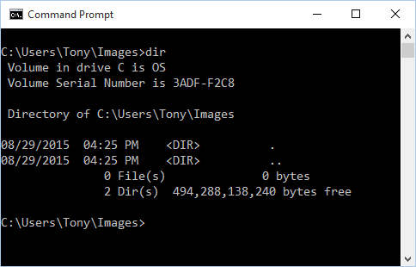
Graphical User Interfaces (cont’d.)
A command line interface

Slide 5
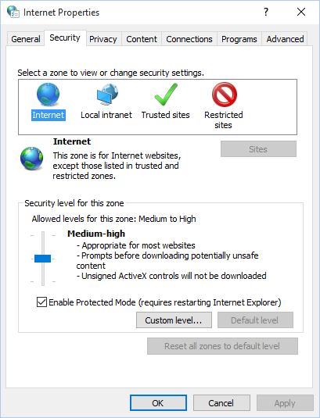
Graphical User Interfaces (cont’d.)
Dialog boxes: small windows that display information and allow the user to perform actions
  Responsible for most of the interaction through GUI
  User interacts with graphical elements such as icons, buttons, and slider bars

Slide 6
GUI Programs Are Event-Driven
In text-based environments, programs determine the order in which things happen
  The user can only enter data in the order requested by the program
GUI environment is event-driven
  The user determines the order in which things happen
    User causes events to take place and the program responds to the events

Slide 7
Using the tkinter Module
No GUI programming features built into Python
tkinter module: allows you to create simple GUI programs
  Comes with Python
Widget: graphical element that the user can interact with or view
  Presented by a GUI program

Slide 8
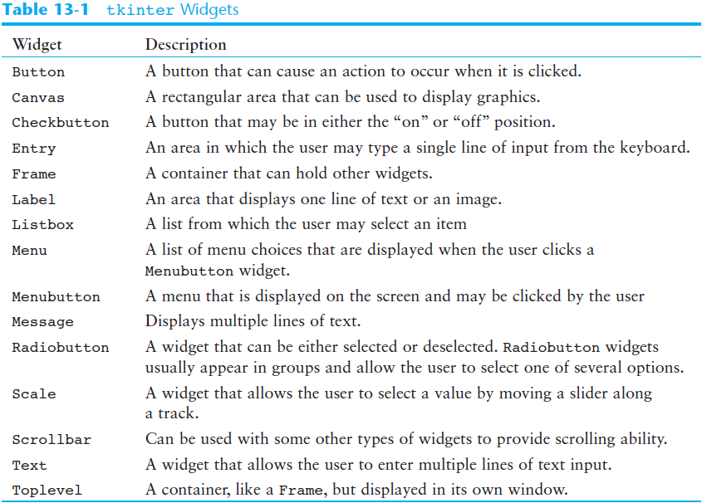

Slide 9
Using the tkinter Module (cont’d.)
Programs that use tkinter do not always run reliably under IDLE
  For best results run them from operating system command prompt
Most programmers take an object-oriented approach when writing GUI programs
  __init__ method builds the GUI
  When an instance is created the GUI appears on the screen

Slide 10
Display Text with Label Widgets
Label widget: displays a single line of text in a window
  Made by creating an instance of tkinter module’s Label class
  Format: tkinter.Label(self.main_window, text = 'my text')
    First argument references the root widget, second argument shows text that should appear in label

Slide 11
Display Text with Label Widgets (cont’d.)
pack method: determines where a widget should be positioned and makes it visible when the main window is displayed
  Called for each widget in a window
  Receives an argument to specify positioning
    Positioning depends on the order in which widgets were added to the main window
    Valid arguments: side='top', side='left', side='right'

Slide 12
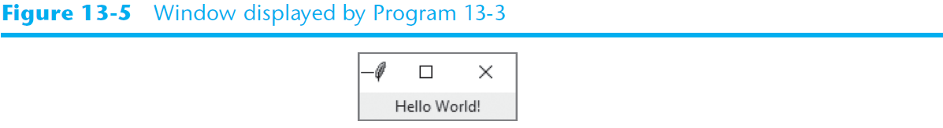
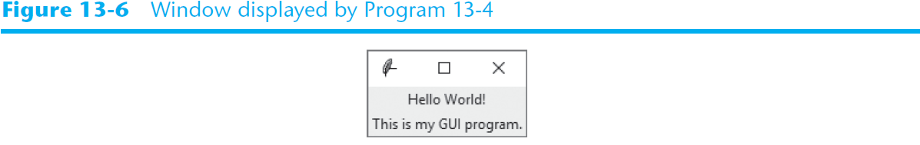
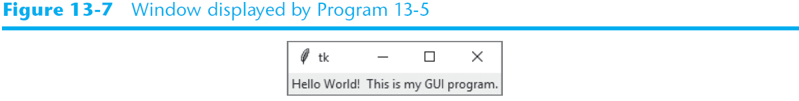
Display Text with Label Widgets (cont’d.)

Slide 13
Organizing Widgets with Frames
Frame widget: container that holds other widgets
  Useful for organizing and arranging groups of widgets in a window
  The contained widgets are added to the frame widget which contains them
    Example:
    tkinter.Label(self.top_frame, text = 'hi')

Slide 14
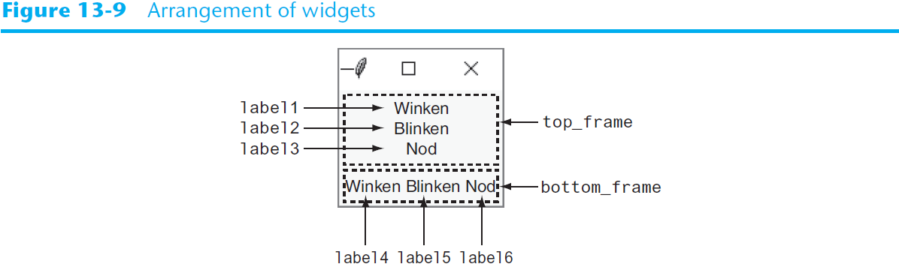
Organizing Widgets with Frames (cont’d.)

Slide 15
Button Widgets and Info Dialog Boxes
Button widget: widget that the user can click to cause an action to take place
  When creating a button can specify:
    Text to appear on the face of the button
    A callback function
Callback function: function or method that executes when the user clicks the button
  Also known as an event handler

Slide 16
Button Widgets and Info Dialog Boxes (cont’d.)
Info dialog box: a dialog box that shows information to the user
  Format for creating an info dialog box:
    Import tkinter.messagebox module
    tkinter.messagebox.showinfo(title,
    message)
      title is displayed in dialog box’s title bar
      message is an informational string displayed in the main part of the dialog box

Slide 17
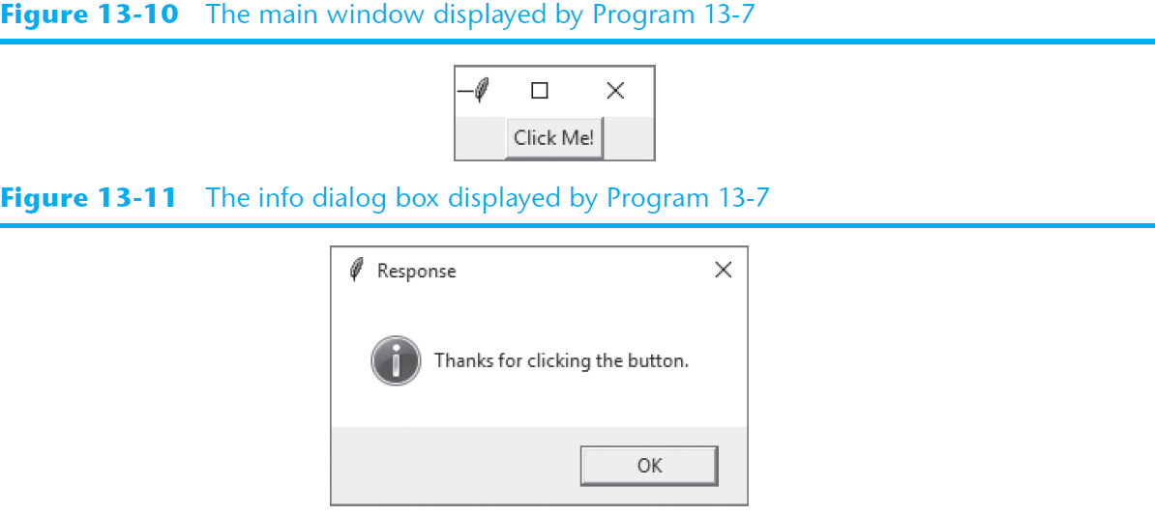
Button Widgets and Info Dialog Boxes (cont’d.)

Slide 18
Creating a Quit Button
Quit button: closes the program when the user clicks it
To create a quit button in Python:
  Create a Button widget
  Set the root widget’s destroy method as the callback function
    When the user clicks the button the destroy method is called and the program ends

Slide 19
Getting Input with the Entry Widget
Entry widget: rectangular area that the user can type text into
  Used to gather input in a GUI program
  Typically followed by a button for submitting the data
    The button’s callback function retrieves the data from the Entry widgets and processes it
  Entry widget’s get method: used to retrieve the data from an Entry widget
    Returns a string

Slide 20
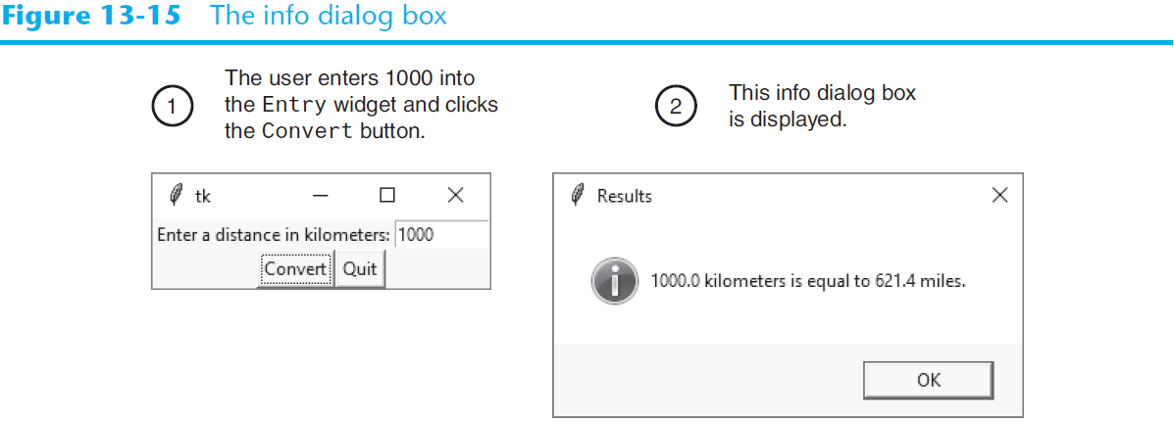
Getting Input with the Entry Widget (cont’d.)

Slide 21
Using Labels as Output Fields
Can use Label widgets to dynamically display output
  Used to replace info dialog box
  Create empty Label widget in main window, and write code that displays desired data in the label when a button is clicked

Slide 22
Using Labels as Output Fields (cont’d.)
StringVar class: tkinter module class that can be used along with Label widget to display data
  Create StringVar object and then create Label widget and associate it with the StringVar object
  Subsequently, any value stored in the StringVar object with automatically be displayed in the Label widget

Slide 23
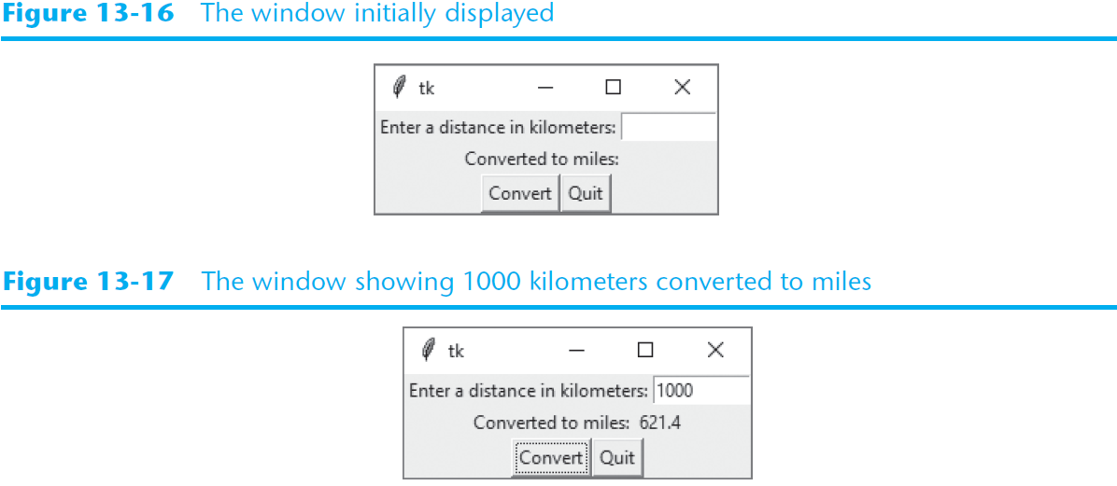
Using Labels as Output Fields (cont’d.)

Slide 24
Radio Buttons and Check Buttons
Radio button: small circle that appears filled when it is selected and appears empty when it is deselected
  Useful when you want the user to select one choice from several possible options
Radiobutton widgets: created using tkinter module’s Radiobutton class
  Radiobutton widgets are mutually exclusive
    Only one radio button in a container may be selected at any given time

Slide 25
Radio Buttons and Check Buttons (cont’d)
IntVar class: a tkinter module class that can be used along with Radiobutton widgets
  Steps for use:
    Associate group of Radiobutton widgets with the same IntVar object
    Assign unique integer to each Radiobutton
    When a Radiobutton widgets is selected, its unique integer is stored in the IntVar object
  Can be used to select a default radio button

Slide 26
Using Callback Functions with Radiobuttons
You can specify a callback function with Radiobutton widgets
  Provide an argument command=self.my_method when creating the Radiobutton widget
  The command will execute immediately when the radio button is selected
  Replaces the need for a user to click OK or submit before determining which Radiobutton is selected

Slide 27
Check Buttons
Check button: small box with a label appearing next to it; check mark indicates when it is selected
  User is allowed to select any or all of the check buttons that are displayed in a group
    Not mutually exclusive
Checkbutton widgets: created using tkinter module’s Checkbutton class
  Associate different IntVar object with each Checkbutton widget

Slide 28
Drawing Shapes with the Canvas Widget
The Canvas widget is a blank, rectangular area that allows you to draw simple 2D shapes.
You use the Canvas widget's screen coordinate system to specify the location of your graphics.
The coordinates of the pixel in the upper-left corner of the screen are (0, 0).
  The X coordinates increase from left to right
  The Y coordinates increase from top to bottom.

Slide 29
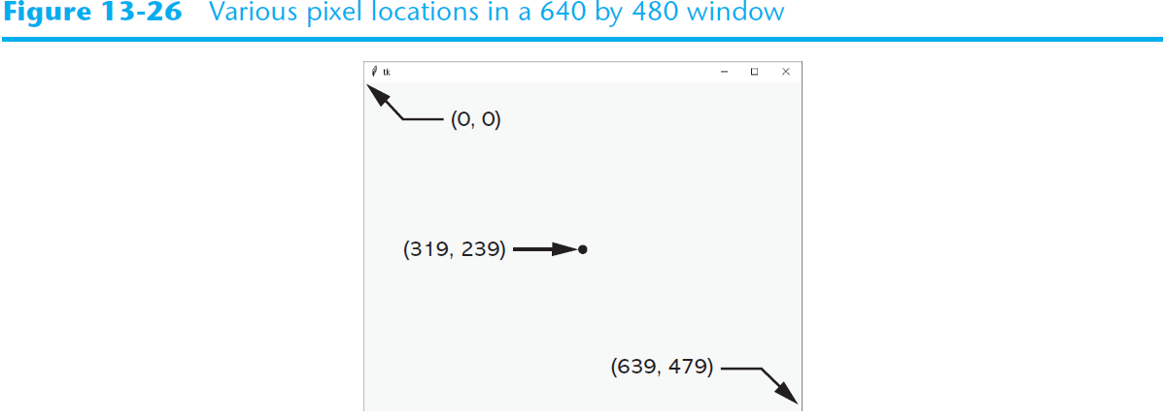
Drawing Shapes with the Canvas Widget

Slide 30
Drawing Shapes with the Canvas Widget
Creating a Canvas widget:
# Create the main window.
self.main_window = tkinter.Tk()
# Create the Canvas widget.
self.canvas = tkinter.Canvas(self.main_window, width=200, height=200)

Slide 31
Drawing Shapes with the Canvas Widget
The Canvas widget has numerous methods for drawing graphical shapes on the surface of the widget.
The methods that we will discuss are:
  create_line
  create_rectangle
  create_oval
  create_arc
  create_polygon
  create_text

Slide 32
Drawing a Line
Coordinates of
the line's ending
point
canvas_name.create_line(x1, y1, x2, y2, options…)
Coordinates of
the line's starting
point
Optional arguments
(See Table 13-2)

Slide 33
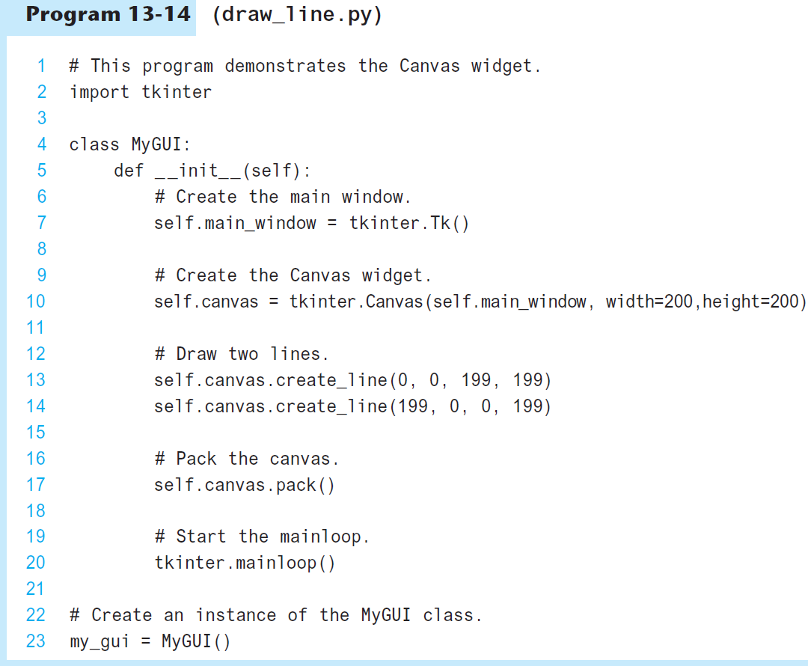
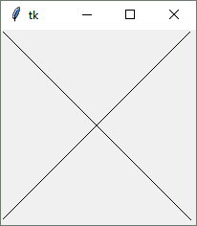

Slide 34
Drawing a Rectangle
Coordinates of
the lower-right
corner
canvas_name.create_rectangle(x1, y1, x2, y2, options…)
Coordinates of
the upper-left
corner
Optional arguments
(See Table 13-3)

Slide 35
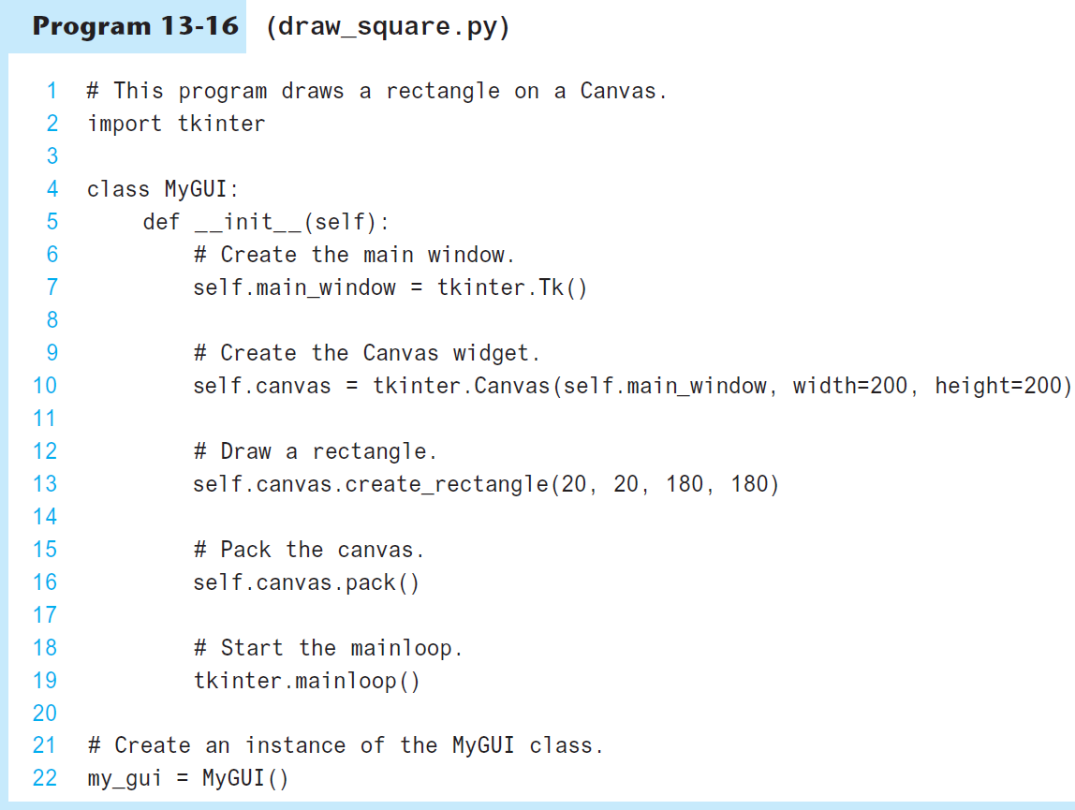
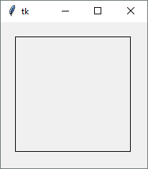

Slide 36
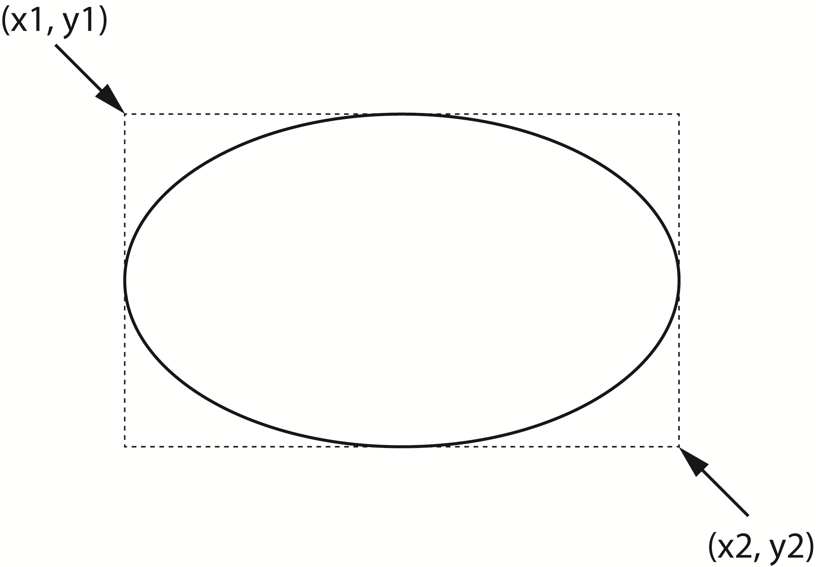
Drawing an Oval
Coordinates of
the lower-right
corner of
bounding rectangle
canvas_name.create_oval(x1, y1, x2, y2, options…)
Coordinates of
the upper-left
corner of
bounding rectangle
Optional arguments
(See Table 13-4)

Slide 37
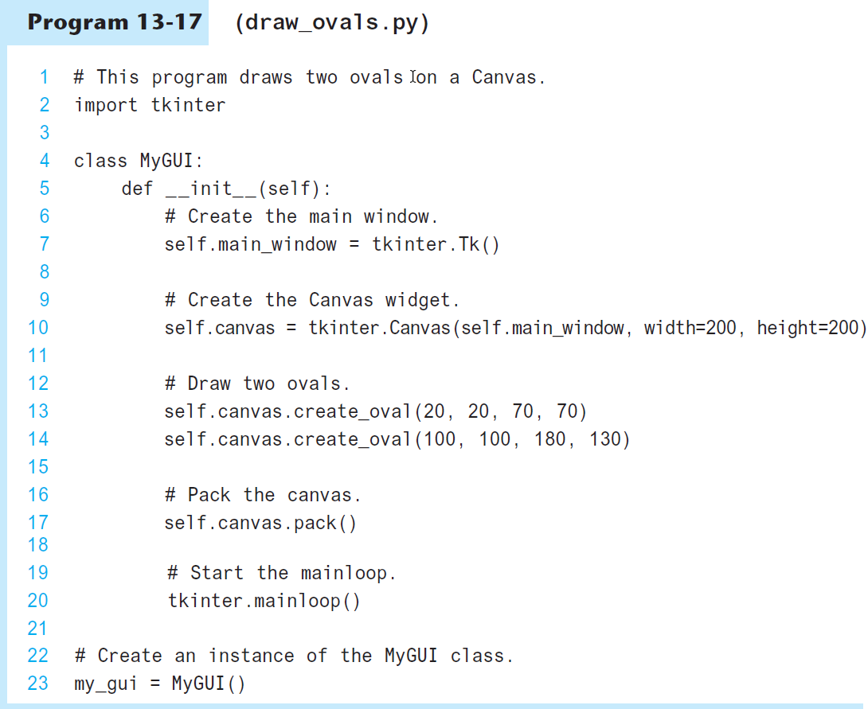
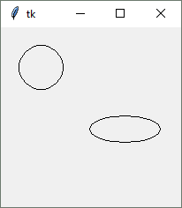

Slide 38
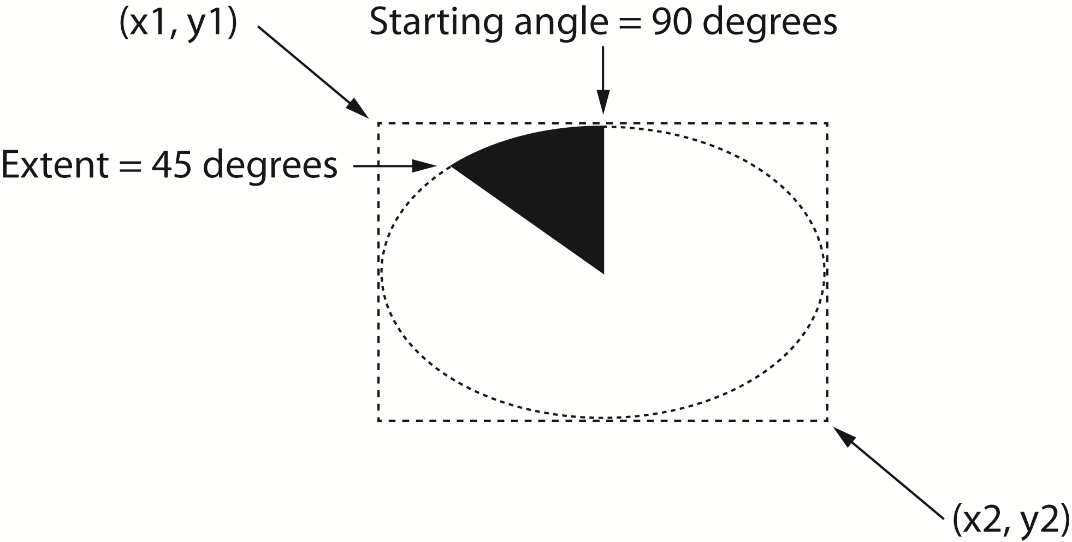
Drawing an Arc
Coordinates of
the upper-left
corner of
bounding rectangle
Coordinates of
the lower-right
corner of
bounding rectangle
canvas_name.create_arc(x1, y1, x2, y2,
start=angle, extent=width,
options…)
Starting angle
Counter clockwise
extent of the arc
Optional arguments
(See Table 13-5)

Slide 39
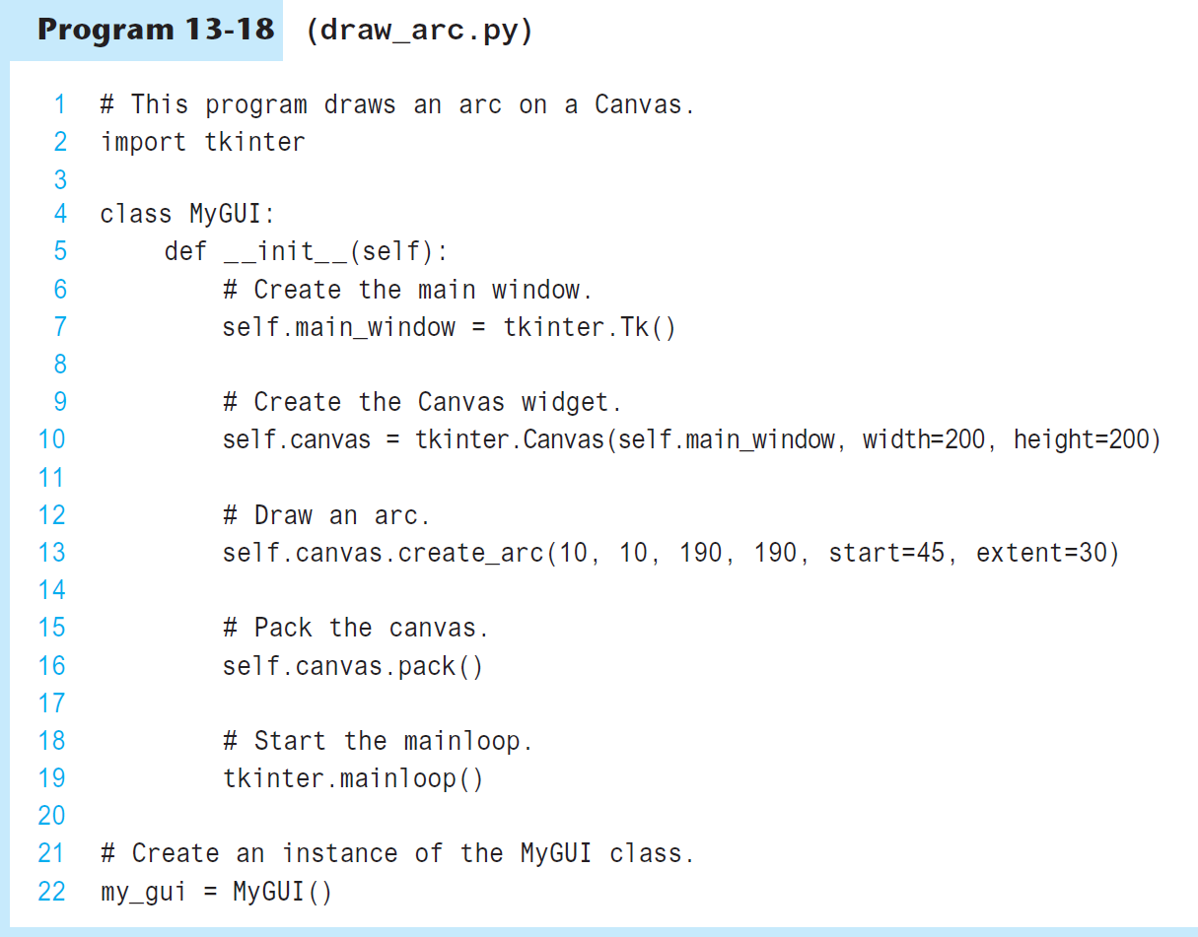
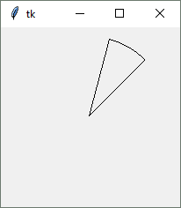

Slide 40
Drawing a Polygon
Coordinates of
the second vertex
canvas_name.create_polygon(x1, y1, x2, y2, …,options…)
Coordinates of
the first vertex
Optional arguments
(See Table 13-7)

Slide 41
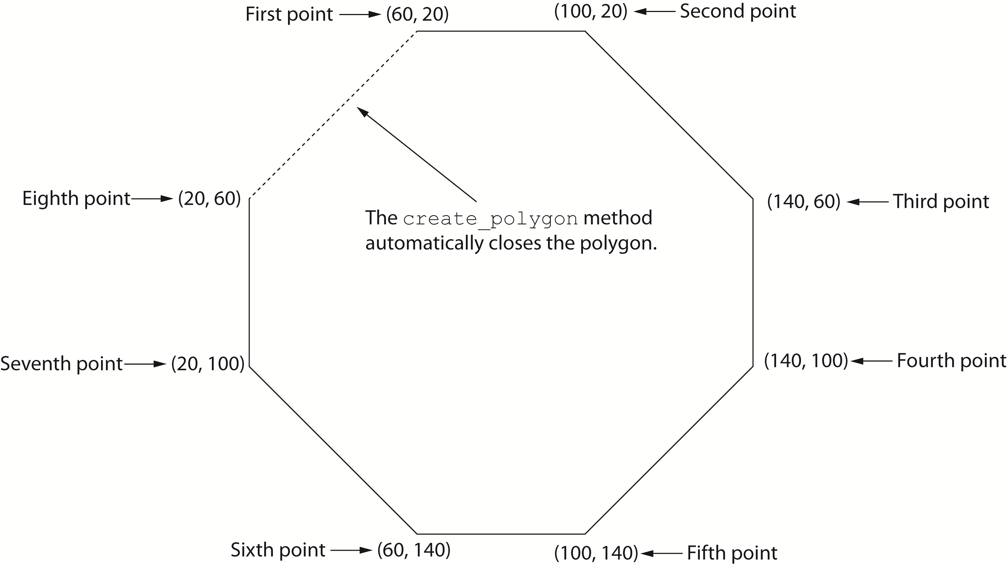
Drawing a Polygon
self.canvas.create_polygon(60, 20, 100, 20, 140, 60, 140, 100,
100, 140, 60, 140, 20, 100, 20, 60)

Slide 42
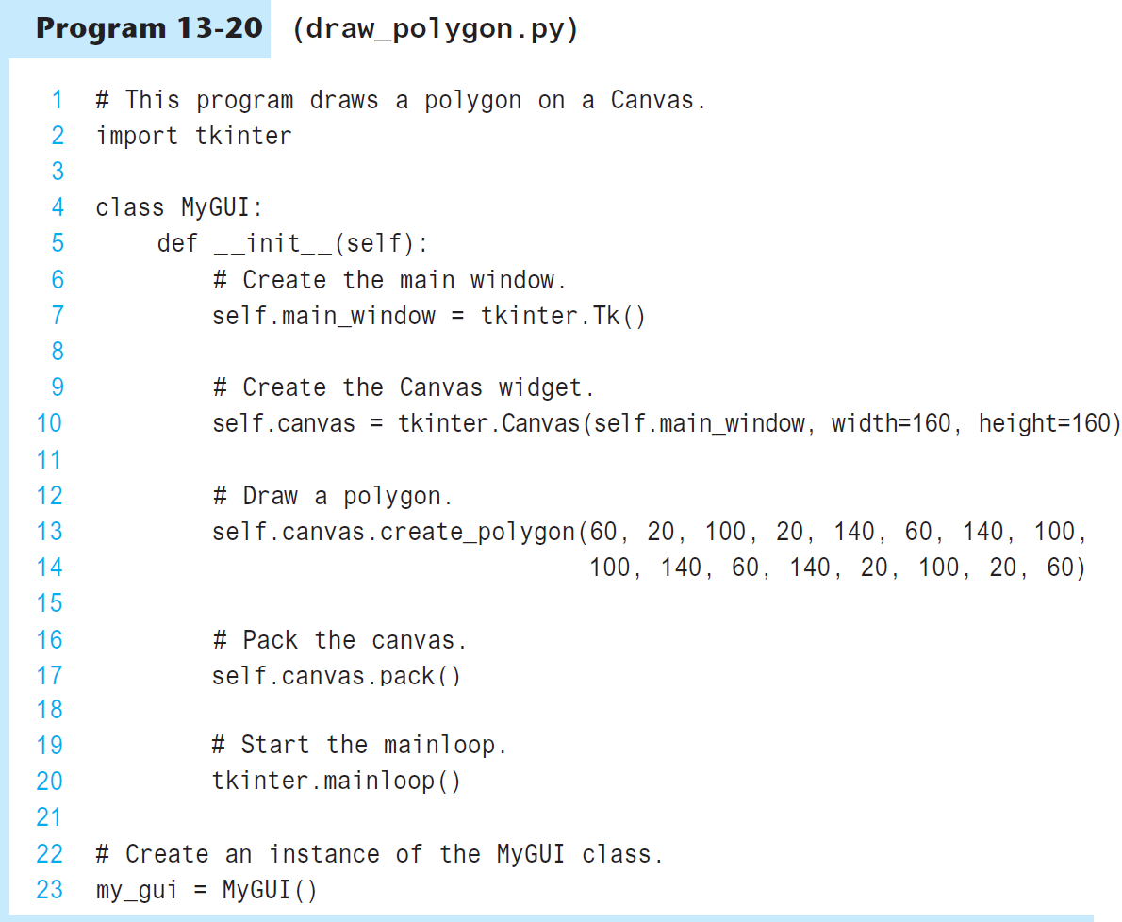
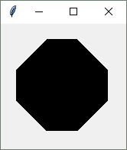

Slide 43
Displaying Text on the Canvas
Text to display
canvas_name.create_text(x, y, text=text, options…)
Coordinates of
the text's insertion
point
Optional arguments
(See Table 13-8)

Slide 44
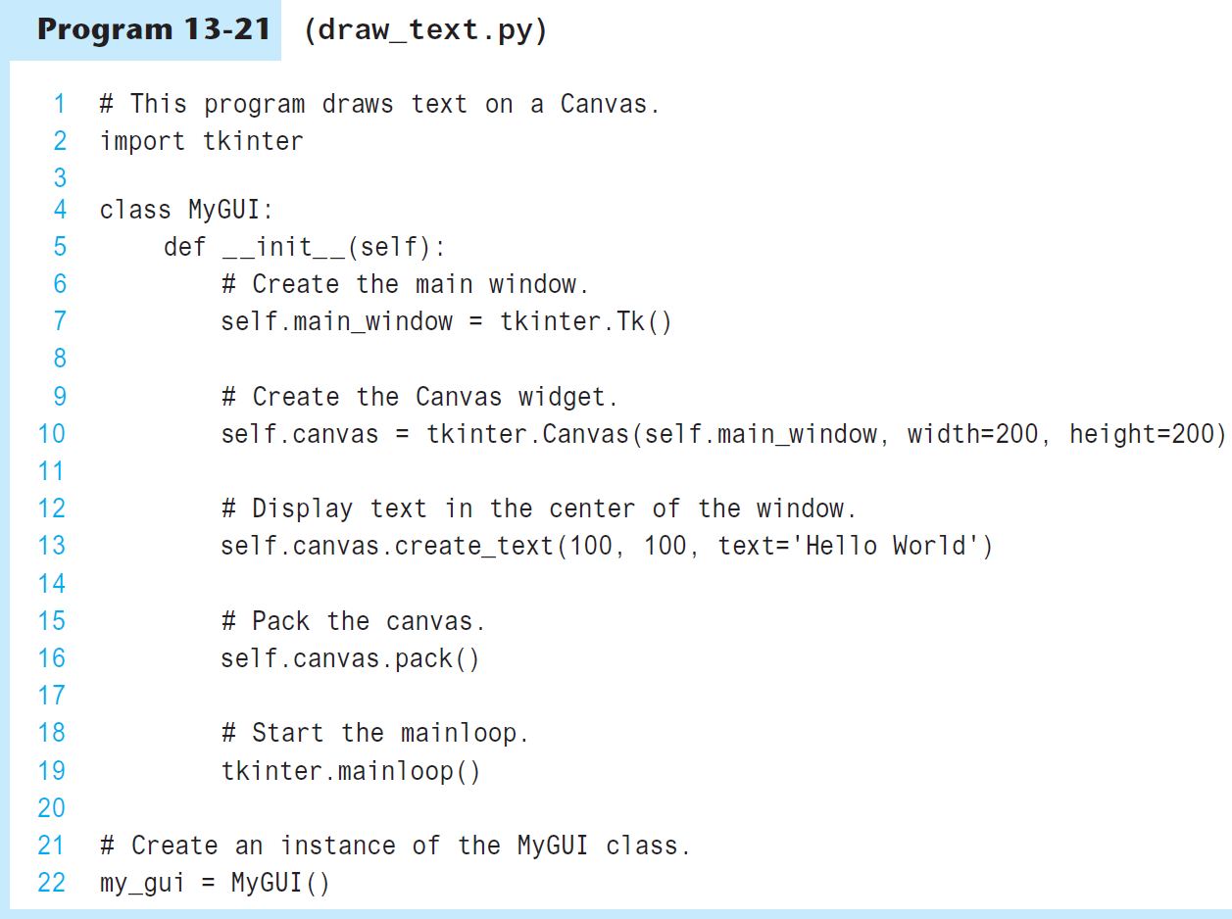
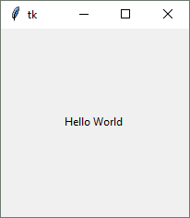

Slide 45
Summary
This chapter covered:
  Graphical user interfaces and their role as event-driven programs
  The tkinter module, including:
    Creating a GUI window
    Adding widgets to a GUI window
    Organizing widgets in frames
    Receiving input and providing output using widgets
    Creating buttons, check buttons, and radio buttons
    Drawing simple shapes with the Canvas widget

